Slide 1
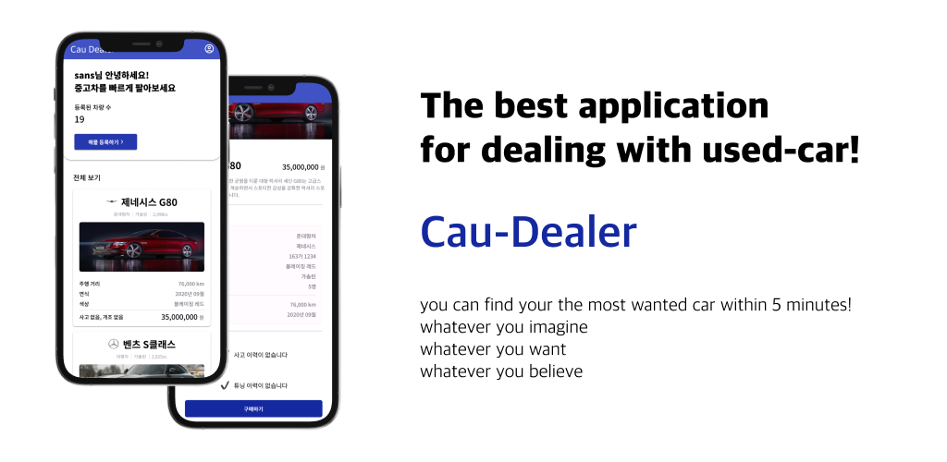
유용민 설지환 안지완 이의제
이주형 채승운 이동욱

Slide 2
Application
👉 Function
- The simple application that simplify all the used-car trades between ‘buyer’ and ‘seller’.
👉 Vision
- User can easily trade used-cars via our application.
- User can make trade with absolute trust
- Build the software architecture that satisfies good OOP properties especially Inheritance, Polymorphism, Abstraction and Java Standard Library

Slide 3



Architecture(Tech Stack)
JVM(Java Virtual Machine)
Object
Android Library
Car
Database System Manager
User
Java
Standard Library
Accident
Data
Firebase Library
Tune

Slide 4
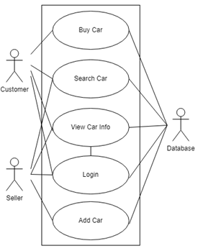
Architecture(UML) – User
User
Login
Search Car
View Car Info
com.google.firebase.firestore
FirebaseFirestore
QueryDocumentSnapshot
Firebase Document
Customer
Seller
Buy Car
Add Car

Slide 5
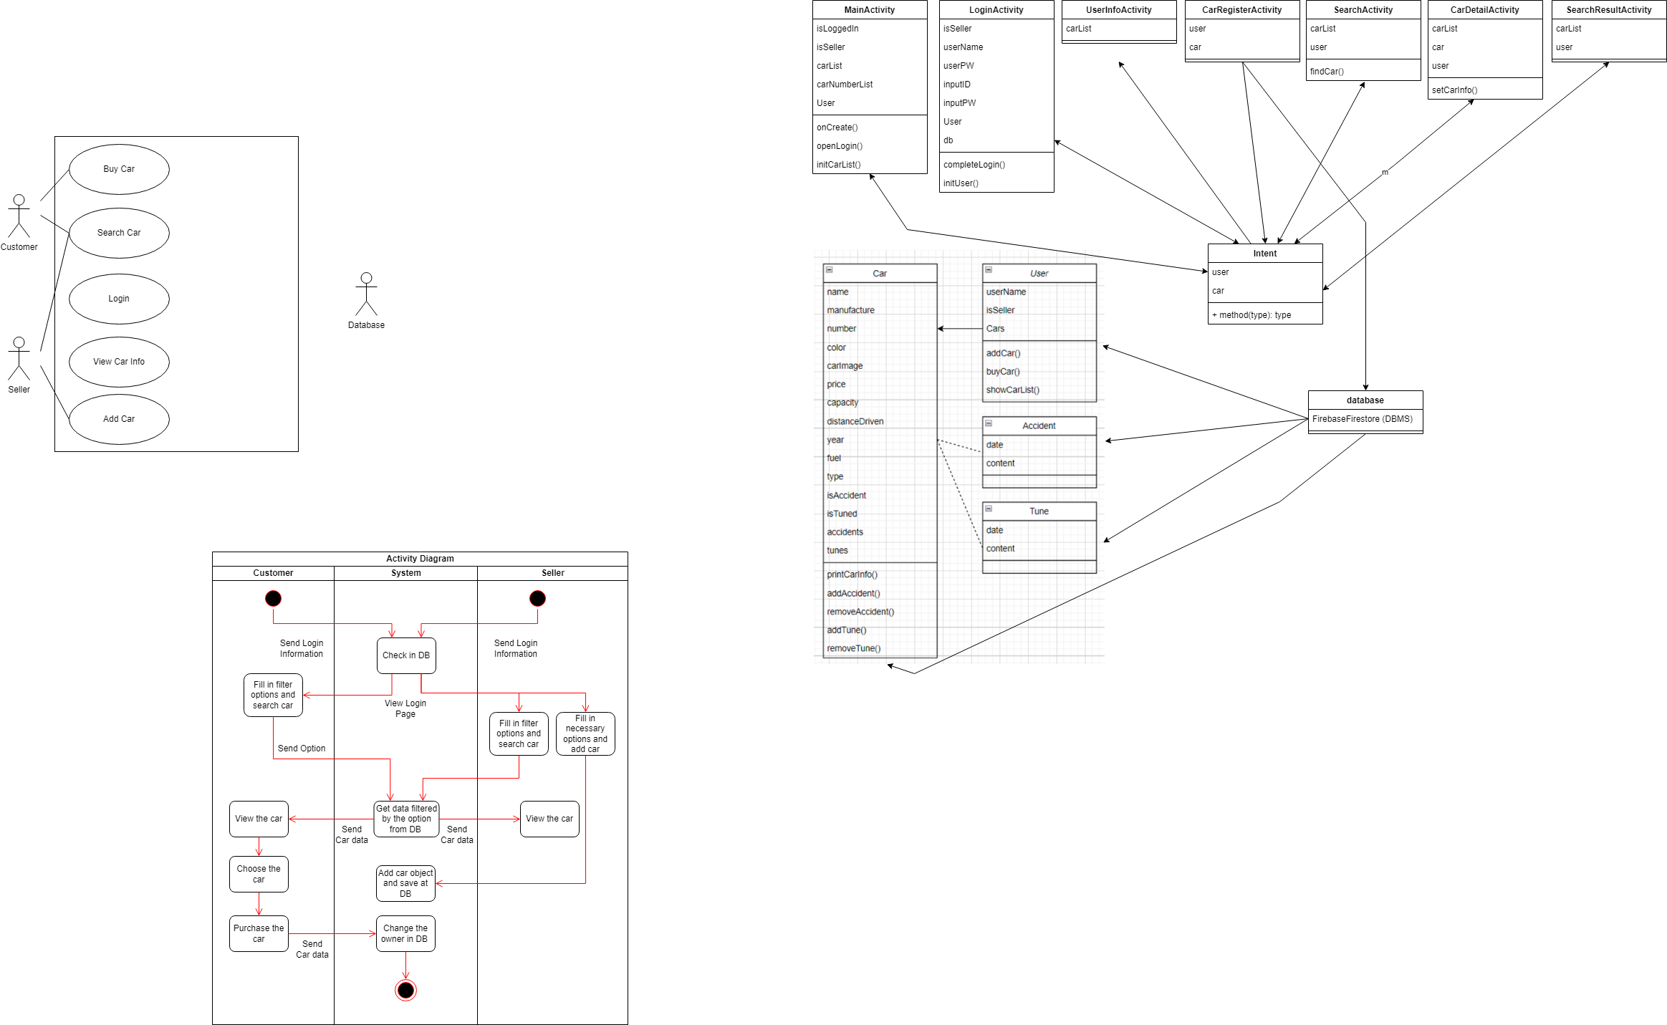
Architecture(UML) - Logic
android.app.Activity
Android Document
LoginActivity
CarRegisterActivity
SearchActivity
SearchResultActivity
MainActivity
CarDetailActivity
UserInfoActivity

Slide 6
Architecture(UML) - Object

Slide 7
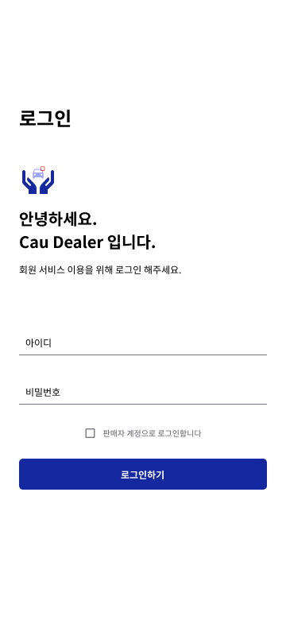
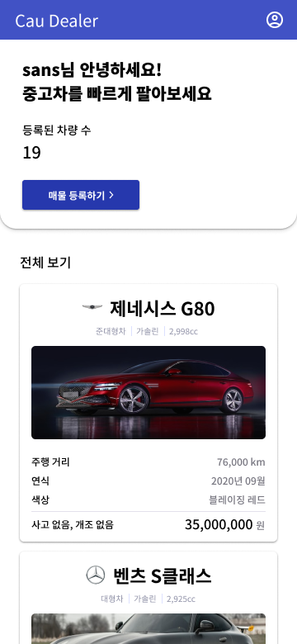
User Flow
LoginActivity
MainActivity

Slide 8
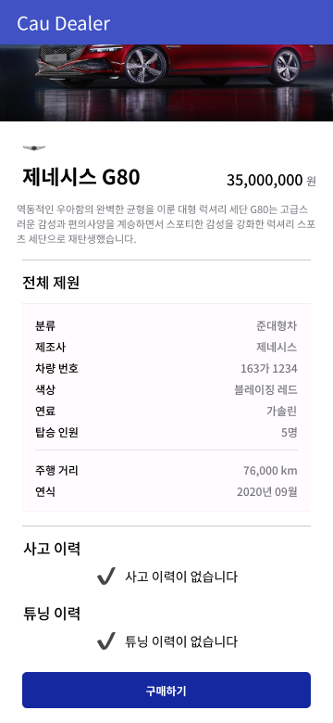
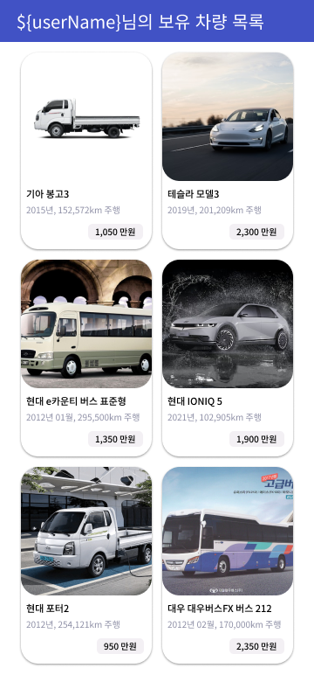
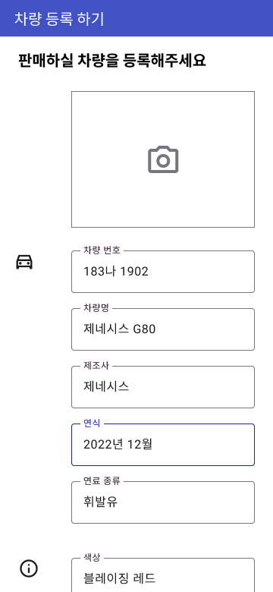
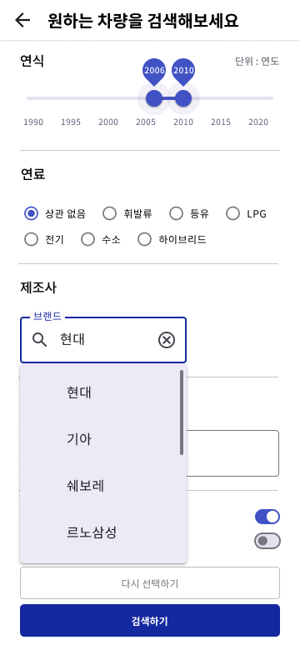
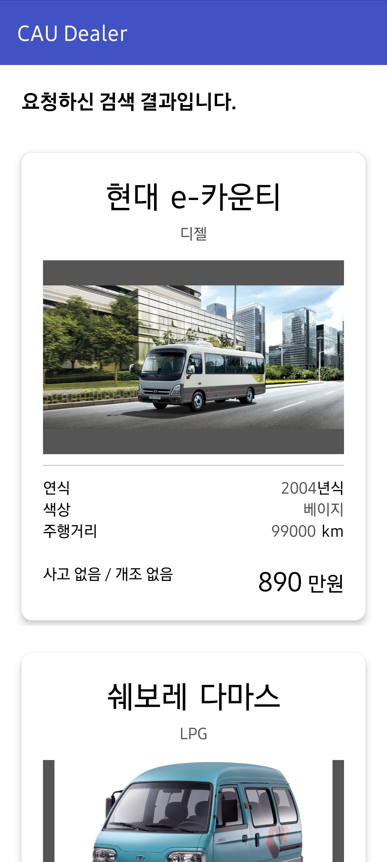
CarDetailActivity
UserInfoActivity
CarRegisterActivity
SearchActivity
SearchResultActivity

Slide 9
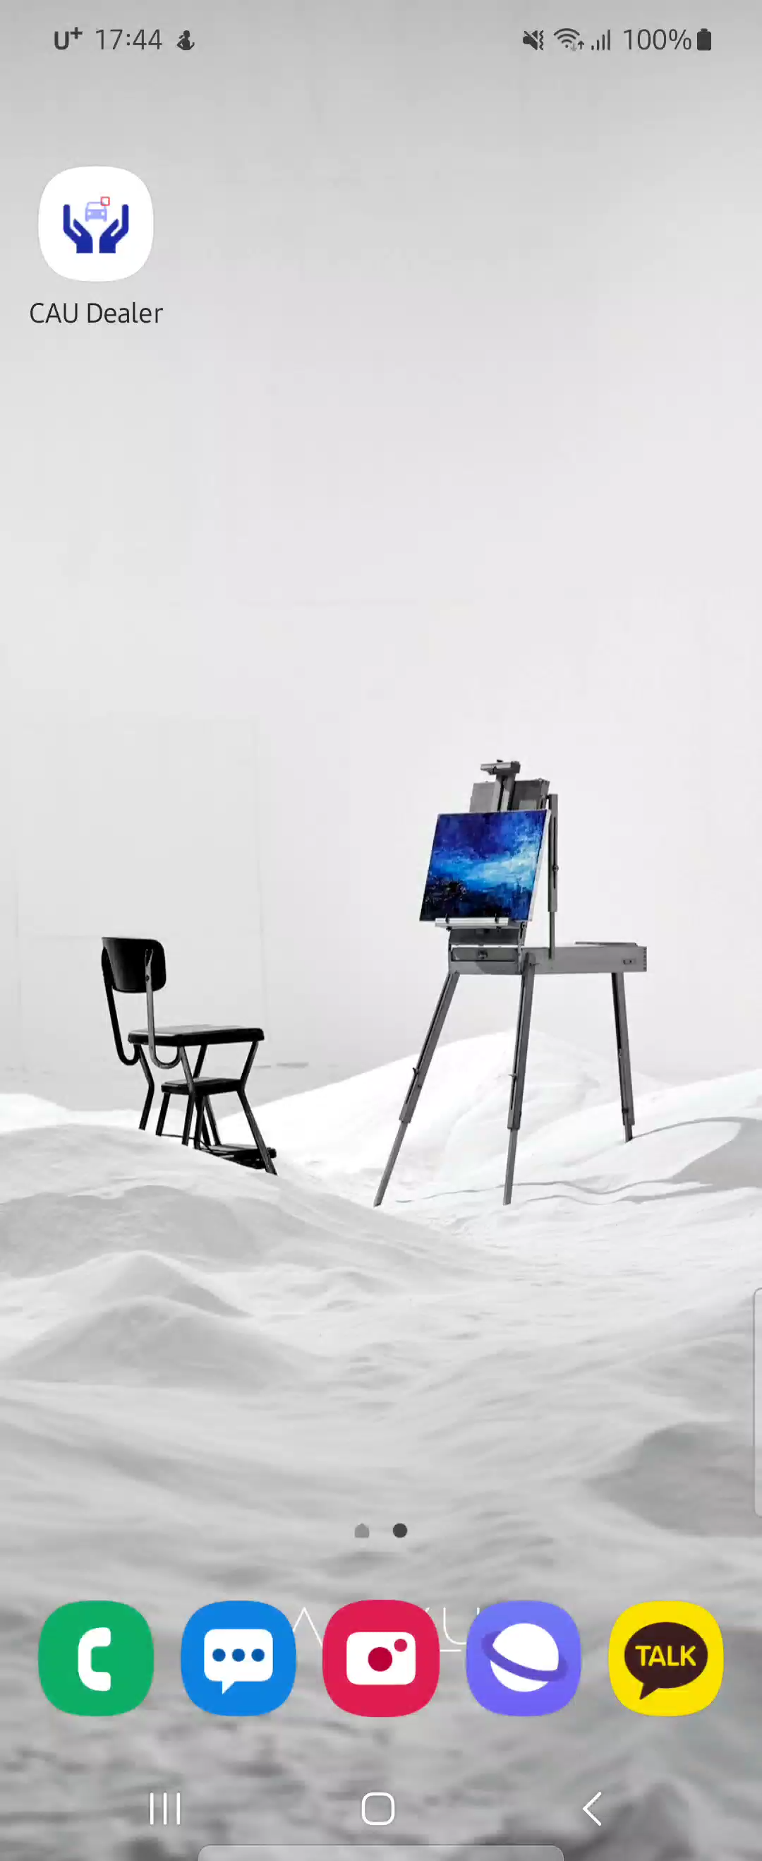
User Flow – LoginAcitivity
User
Android Library
Data

Slide 10
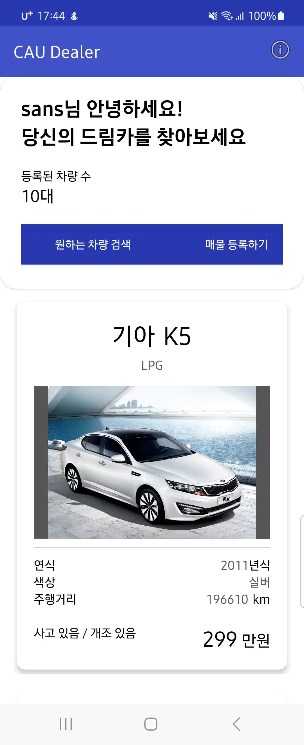
User Flow - MainActivity
User
Android Library
addCar()
Data

Slide 11
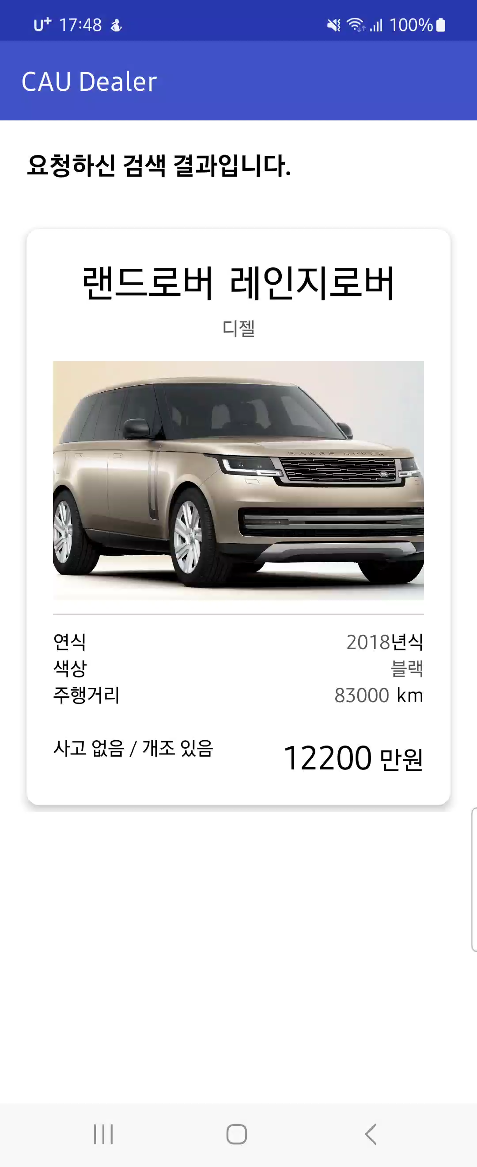
User Flow – CarDetailActivity, UserInfo-
User
Android Library
addCar()
Data

Slide 12

User Flow - CarRegisterActivity
User
Android Library
addCar()
Data

Slide 13

User Flow – SearchActivity, SearchDetail-
User
findCar()
Android Library
CarDetailActivity
Data

Slide 14
Conclusion
👉 Inheritance
- Three main classes we implemented in the project are ‘User’, ‘Car’, and ‘Activity,’ and there exists an inheritance process between the subclasses
👉 OOP built-in library
- While using the built-in library in android, we could find the library’s flawless structure of the class designing, that satisfied the requirements of the good program
👉 Compatibility with database
- We had to override various properties and functions in order to work well in completely different environment (firebase)

Slide 15
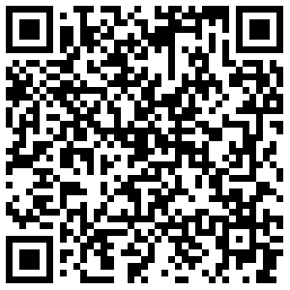

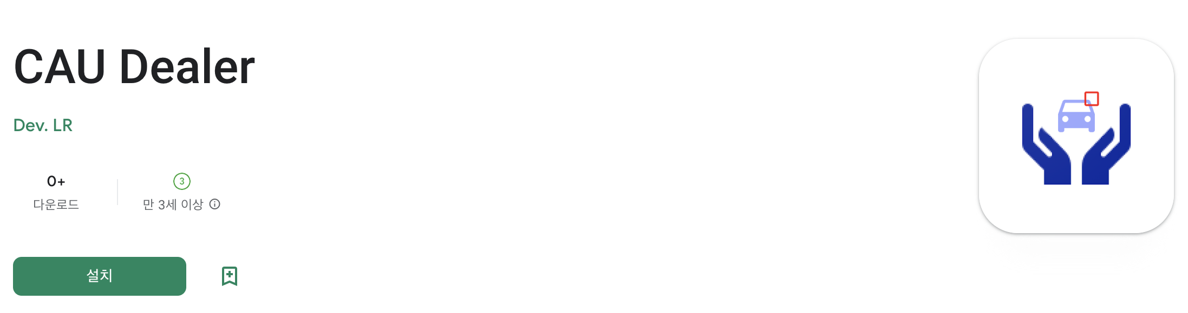
ID : cau_student
PW: 1234
*caution – the first image loading time will take about 30s

